Slide 1
Uploading Your Work to eCO
A step-by-step tutorial

Slide 2
When is an electronic copy acceptable?
An electronic copy of the work being registered may be uploaded directly into eCO if it is within one of the following categories:
Unpublished work
Work published only electronically
Published work for which the deposit requirement is identifying material
Published work for which there are special agreements requiring a hard-copy deposit to be sent separately to the Library of Congress
For works where a hard-copy is required, you can still submit an application and payment by eCO and send copies of your work to the Copyright Office by the U.S. Postal Service or express courier.

Slide 3
Completing Your Submission
After payment is confirmed, you must send a copy of your work to complete the submission process.
Click here to send a copy of your work.

Slide 4
Before You Upload Your Work
Please review the screen instructions before uploading your work.
Click the blue links for helpful information about copy requirements and file type and size limitations.
The application(s) you just submitted with payment will be listed on this screen.

Slide 5
Uploading a Copy of Your Work
Click here to upload an electronic copy of your work(s).
Click the “Title” link to see all the titles you entered (optional).

Slide 6
Selecting Files to Upload
A new window will open, allowing you to select the file(s) for this work from your computer.
Select file(s) to be uploaded and click “Open.”

Slide 7
Uploading the Selected Files
Click here to upload your file(s).
Remove any incorrect files before uploading.
The file(s) you selected will be displayed with the corresponding work.

Slide 8
Confirming Submission Completeness
The Copyright Office cannot begin processing applications with uploaded deposit copies until you confirm that all files have been sent.
Click here when all files for this application have been uploaded.

Slide 9
Upload Completed
No more files may be uploaded for this work.
You will receive an email from the Copyright Office confirming receipt of your file(s).
After files are received, you can click here to view a list (please allow up to one hour).

Slide 10
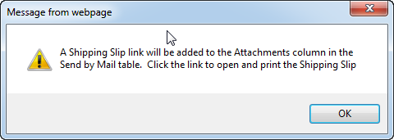
Mailing a Copy of Your Work
If you determine that an electronic copy of your work is not acceptable, the hard-copy you mail must be accompanied by a shipping slip.
Please do not send both electronic and hard-copies.
Click “OK”
Click here to create a shipping slip for sending your work by mail.
(This will take a few seconds.)

Slide 11
Mailing a Copy of Your Work
If you submitted multiple applications together with one payment, a shipping slip will be created for each application.
Click the attachment link to open and print the shipping slip(s).

Slide 12
Printing a Shipping Slip
Attach the shipping slip corresponding to each work to it before mailing.
Mail the work(s) to the address printed on the shipping slip

Slide 13
Questions?
For technical assistance, contact us at:
1 (877) 476-0778 (toll free) or 1 (202) 707-3002
8:00 – 8:00 EST, Monday – Friday
ctoinfo@loc.gov
For all other questions:
1 (877) 476-0778 (toll free) or 1 (202) 707-3000
8:00 – 8:00 EST, Monday – Friday
copyinfo@loc.gov

