Slide 1


A Complete Guide to
Cable Statements of Account
A Tutorial for Form SA3

Slide 2
What is the statutory license for cable systems?
Getting Started > Account Info > Revenues > Fees > Certification > Interest > DSE > Contact
The Section 111 license permits a cable operator to retransmit both radio and television signals to its subscribers who pay a fee for such service.
The purpose of Section 111 is to permit cable systems to carry broadcast signals while compensating copyright owners for the public performance of their works, without the transaction costs associated with marketplace negotiations for the carriage of copyrighted programs.
Section 111 allows cable operators to complement the carriage of local broadcast signals with distant signal programming that is generally unavailable in local markets.

Slide 3
What is a cable system?
Getting Started > Account Info > Revenues > Fees > Certification > Interest > DSE > Contact
Cable system: A “cable system” is defined as “a facility, located in any State, territory, trust territory, or possession of the United States, that in whole or in part receives signals transmitted or programs broadcast by one or more television broadcast stations licensed by the FCC and makes secondary transmissions of such signals or programs by wires, cables, microwave, or other communications channels to subscribing members of the public who pay for such service.”
The Copyright Office defines an individual cable system as a cable system recognized as a distinct entity under the rules, regulations, and practices of the FCC. In addition, two or more cable facilities are considered as one individual cable system if:
  (A) the facilities are in contiguous communities and are under common ownership or control; or (B) the facilities operate from one headend.
  Thus, even if two cable facilities are owned by different entities, they will
  be considered as one individual cable system if they share a common headend.

Slide 4
What are the conditions for using the statutory license for cable systems?
Getting Started > Account Info > Revenues > Fees > Certification > Interest > DSE > Contact
To be eligible to use the section 111 license, cable systems must:
  Meet the statutory definition of cable system http://www.copyright.gov/title17/92chap1.html#111
  file statement of account (SOA) forms with the Copyright Office and pay royalty and filing fees every six months
  not add or delete any content carried on any broadcast signals
  carry signals in compliance with the rules and regulations of the Federal Communications Commission (FCC)
  retransmit content simultaneously with actual broadcasts

Slide 5
Why file an SOA?
Getting Started > Account Info > Revenues > Fees > Certification > Interest > DSE > Contact
Copyright law requires a cable system to file SOAs:
  to show the criteria for the semiannual royalty and filing fees the cable system owes under its statutory license; and
  to report the information needed to allocate royalties among copyright owners.
SOAs are official documents. Cable systems must certify that the information they contain is true and accurate. Copyright licensing examiners cannot change or modify any SOA.
All information in an SOA must accurately represent the facts as they existed during the accounting period covered by the statement (or, in certain cases, on the last day
of that period).

Slide 6
What does the licensing examiner do?
Getting Started > Account Info > Revenues > Fees > Certification > Interest > DSE > Contact
The licensing examiner analyzes the SOA form to determine whether:
  the SOA was prepared according to the rules and regulations of the
  Copyright Office, including obvious errors or omissions to be corrected before final processing;
  the correct royalty and filing fees have been paid; and
  the statutory time limits for filing have been met.
If an examiner discovers missing or questionable information, or an incorrectly calculated royalty filing fee the examiner will call or write the cable system.
Carefully review and verify information before submitting the SOA form.
Interest accrues on underpayments and late payments.
Note: It is the responsibility of the cable system to ensure all information
is correct.

Slide 7
When to file?
Getting Started > Account Info > Revenues > Fees > Certification > Interest > DSE > Contact
Cable systems have 60 days after the close of each accounting period in which
to file SOAs and pay royalty and filing fees. Here are the two filing dates:
  For the January–June accounting period: File between July 1
  and August 29, inclusive;
  For the July–December accounting period: File between January 1
  and March 1, inclusive.
If August 29 or March 1 falls on a weekend or a federal holiday, SOAs
and royalty and filing fees can be filed on the following business day.

Slide 8
Where to file?
Getting Started > Account Info > Revenues > Fees > Certification > Interest > DSE > Contact
For further information, call (202) 707-8150 or email licensing@copyright.gov.
Electronic Submission Option:
Access the fillable Excel version of the SOA (SA3E Long Form) at https://www.copyright.gov/licensing/sec_111.html.
Fill out the required information and email the Excel file to coplicsoa@copyright.gov.
Paper Submission Option:
Access the fillable PDF version of the SOA (Paper SA3 Long Form) at https://www.copyright.gov/licensing/sec_111.html.
You can mail your submission to:
Library of Congress
Copyright Office-LD
101 Independence Avenue SE
Washington, DC 20557-6400
Or you can deliver your submission in person to Room LM-401 at the above address.

Slide 9
Filing Fee
Getting Started > Account Info > Revenues > Fees > Certification > Interest > DSE > Contact
Effective January 1, 2014, pursuant to the Satellite Television Extension and Localism Act of 2010 (STELA), which granted authority to the Copyright Office to establish fees for the filing of statements of account (SOAs) under the section 111, 119, and 122 statutory licenses, the Office now assesses filing fees for ALL SOAs for current, past, and future accounting periods. Licensing Division filing fees:
  Cable SA 3: $725
For details, see the Federal Register, November 29, 2013 (78 FR 71498). Please be advised that the filing fee is deducted before the royalty payment is credited; thus the omission of the appropriate filing fee will result in an underpayment of royalties. Please remit the royalty and filing fee in one EFT payment.
Note: Congress passed the STELA Reauthorization Act of 2014 (STELARA), which the President signed into law on December 4, 2014, as Public Law 113-200. Read
the law at http://copyright.gov/legislation/pl113-200.pdf. For more information on this law (H.R. 5728), visit the FAQ page on the Copyright Office website at
http://www.copyright.gov/licensing/stelara.html.

Slide 10
How to file an SOA
Getting Started > Account Info > Revenues > Fees > Certification > Interest > DSE > Contact
For the current accounting period, access the fillable PDF version at https://www.copyright.gov/forms/sa3.pdf, print it out, and mail it to the Division. Or access the electronic Excel format at https://www.copyright.gov/forms/sa3e.xlsx and email the completed workbook to coplicsoa@copyright.gov.
For past accounting periods, the appropriate forms are available at www.copyright.gov/licensing/saold.html, and the interest rate information is available at www.copyright.gov/licensing/interest-rate.pdf.
Certify the statement of account. The statement of account is not acceptable unless it bears the original handwritten signature. For electronic submissions, an electronic or “s-signature” (e.g., /s/ John Smith) is required.
All copyright royalty and filing fees must be paid electronically. The remittance should be payable to the Register of Copyrights. If you are using Pay.gov (www.pay.gov), contact your bank to determine if your account will accept an Automated Clearing House (ACH) debit. For additional Electronic Funds Transfer (EFT) information visit www.copyright.gov/licensing/index.html.
If mailing, be sure to send the completed statement of account, one legible copy of the statement of account, the DSE schedule, and all continuation sheets.

Slide 11
Can SOAs be amended?
Getting Started > Account Info > Revenues > Fees > Certification > Interest > DSE > Contact
Subject to procedures set forth in the Code of Federal Regulations, cable operators can file amendments to SOAs if:
  any of the information given in an SOA was incorrect or incomplete; or
  the calculation of the royalties payable for a particular accounting period was incorrect, and the amount deposited with the Copyright Office for that period was either too much or too little.
In such instances, corrections to SOAs will be placed on record, and supplemental royalty payments will be received for deposit or refunds will be issued according to Copyright Office regulations.

Slide 12
Space A: Accounting Period
Getting Started > Account Info > Revenues > Fees > Certification > Interest > DSE > Contact
Clearly designate the accounting period.
Make sure to indicate the correct
accounting period in this space.
Important: SOAs must be typed or handwritten
in dark ink, not pencil.

Slide 13
Space B: Owner
Getting Started > Account Info > Revenues > Fees > Certification > Interest > DSE > Contact
Give the full name, business name (if different), address of the legal owner,
and cable ID number as assigned by the Licensing Division.
Reminder: Check the box if this is the system’s first filing.

Slide 14
Space C: System
Getting Started > Account Info > Revenues > Fees > Certification > Interest > DSE > Contact
Give any business name used to identify the business or operation of the system.
Important: You must verify the identification of the cable
system if it is different than the name listed in Space B.

Slide 15
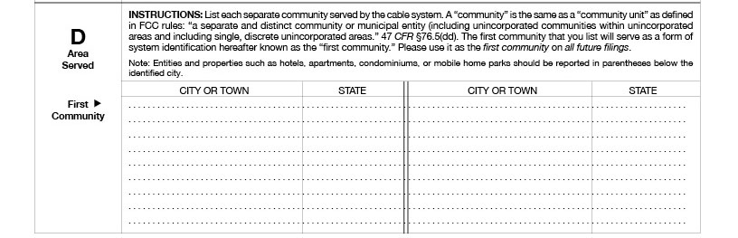
Space D: Area Served
Getting Started > Account Info > Revenues > Fees > Certification > Interest > DSE > Contact
List the name of the community or communities served by the system.
Important: You must
verify the existence
of communities
and spelling of
community names.
Identify repeated
community names
by state and county,
township or other
identifiers.
Please be precise
when reporting
county information
“only some areas”
vs “certain areas.”

Slide 16
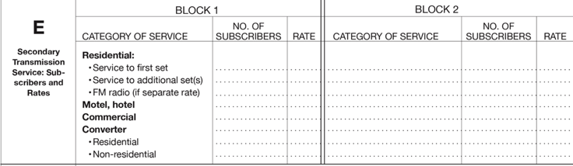
Space E: Secondary Transmission Service
Subscribers and Rates
Getting Started > Account Info > Revenues > Fees > Certification > Interest > DSE > Contact
Give the correct number of subscribers and charges per subscriber.
Important: The number of subscribers and the
rate must be listed in the appropriate columns.
Add more services
in block 2.

Slide 17
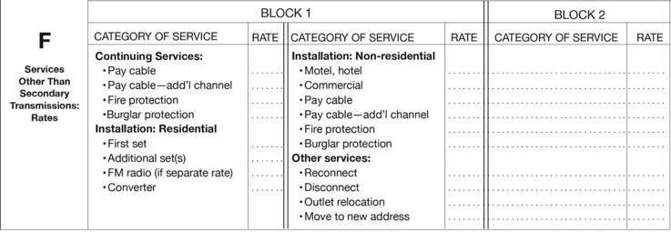
Space F: Services Other Than
Secondary Transmissions
Rates
Getting Started > Account Info > Revenues > Fees > Certification > Interest > DSE > Contact
List rates and describe each package of service that consists solely of services other
than secondary transmissions.
Give rate (not subscriber) information for all cable system services not covered in section E.
Do not give rate information for:
  services furnished at cost; or
  services or facilities furnished to nonsubscribers. Rate information should
  include both the amount of the charge and the unit in which it is usually billed.

Slide 18
Space G: Primary Transmitters
Television
Getting Started > Account Info > Revenues > Fees > Certification > Interest > DSE > Contact
List all network, independent, and educational stations (including translator and low power television stations), simulcast, and multicast streams carried by the cable system.
Check the call sign, broadcast channel number,
station type, distant, basis of carriage if distant
(LAC, E, O), and location of station.

Slide 19
Space H: Primary Transmitters
Radio
Getting Started > Account Info > Revenues > Fees > Certification > Interest > DSE > Contact
Identify primary radio transmitters whose signals were carried by the cable system during the period.

Slide 20
Space I: Substitute Carriage
Special Statement and Program Log
Getting Started > Account Info > Revenues > Fees > Certification > Interest > DSE > Contact
Give the names and titles of the substitute or part-time carriage programs.
Complete the logs showing times, dates, stations, and programs involved
in any nonnetwork television programming that was carried in whole
or in part beyond the local service area of the primary transmitter.

Slide 21
Space J: Part-Time Carriage Log
Getting Started > Account Info > Revenues > Fees > Certification > Interest > DSE > Contact
Give the total dates and hours of carriage if your system listed a station’s basis of carriage as “LAC” for part-time carriage due to lack of activated channel capacity.
All columns must be completed if a station’s basis of
carriage was listed as “LAC” in space G, column 5.

Slide 22
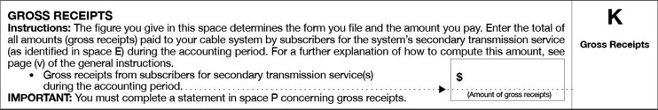
Space K: Gross Receipts
Getting Started > Account Info > Revenues > Fees > Certification > Interest > DSE > Contact
Follow instructions as directed. Errors could lead to an under or over payment when determining the fee owed.
Check that the amount of gross
receipts is at least $527,600 or more.

Slide 23
Space L: Copyright Royalty and Filing Fees
Getting Started > Account Info > Revenues > Fees > Certification > Interest > DSE > Contact
Use the blocks to determine the:
  minimum fee;
  check the appropriate box in Block 2 if distant stations are carried or not carried, and follow the instructions;
  filing fee
  interest (if applicable); and
  total fees.

Slide 24
Space L: Block 1 – Minimum Fee
Getting Started > Account Info > Revenues > Fees > Certification > Interest > DSE > Contact
Enter the amount of gross receipts in line 1. Multiply amount in line 1 by 0.01064.
This amount is the minimum fee.

Slide 25
Space L: Block 2 – Distant Television Stations Carried
Getting Started > Account Info > Revenues > Fees > Certification > Interest > DSE > Contact
If any stations were identified as “distant,” check “Yes” in the block and proceed to
Part 2 of the DSE schedule. If “No,” complete block 4, line 1.

Slide 26
Space L: Block 3 – Base Rate / 3.75 Fee
Getting Started > Account Info > Revenues > Fees > Certification > Interest > DSE > Contact
Leave blank until the DSE Schedule is completed. Enter the
amounts from Parts 6, 8 and/or 9 of the DSE Schedule.

Slide 27
Space L: Block 4 – Total Royalty and
Filing Fees
Getting Started > Account Info > Revenues > Fees > Certification > Interest > DSE > Contact
Important: When you file your SOAs on form SA 3, you must also submit the
royalty and required filing fees you have computed in the blocks above. Your
remittance must be in the form of an electronic payment payable to Register
of Copyrights. For additional Electronic Funds Transfer (EFT) information,
visit www.copyright.gov/licensing/index.html.

Slide 28
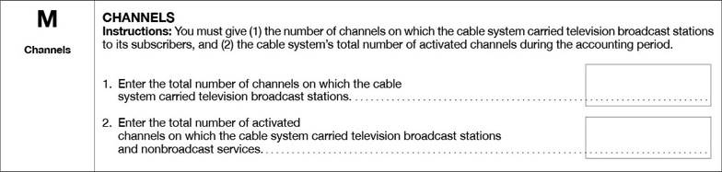
Space M: Channels
Getting Started > Account Info > Revenues > Fees > Certification > Interest > DSE > Contact
Represents the number of broadcast
stations (network, independent, and
educational) reported in Space G.
Represents total number of channels offered by
the cable system (including HBO, Showtime, etc.)
Important: Line 1 must not exceed line 2.

Slide 29
Space N: Contact
Getting Started > Account Info > Revenues > Fees > Certification > Interest > DSE > Contact
Note: For more efficient service, give the name
of the contact person who is familiar with the SOA.
Give the name, address, telephone number, and email of a contact person.

Slide 30
Space O: Certification
Getting Started > Account Info > Revenues > Fees > Certification > Interest > DSE > Contact
Provide identification and handwritten signature of the owner or owner’s agent of the cable system along with the date covering the entire applicable accounting period. Date should be after the close of the accounting period.
Don’t forget: Stamped or
photocopied signatures are
not acceptable.
For electronic submissions,
an electronic or “s-signature”
(e.g. /s/ John Smith) is required.

Slide 31
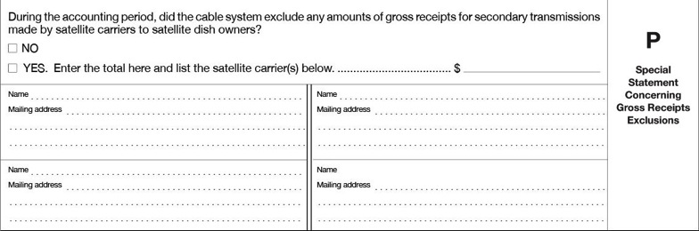
Space P: Special Statement Concerning Gross Receipts Exclusions
Getting Started > Account Info > Revenues > Fees > Certification > Interest > DSE > Contact
Complete only if cable system excluded gross receipts for secondary
transmissions made by satellite carriers to satellite dish owners.

Slide 32
Space Q: Interest Assessment
Worksheet for Computing Interest
Getting Started > Account Info > Revenues > Fees > Certification > Interest > DSE > Contact
Important: Complete
the worksheet for
royalty payments
submitted as a
result of late royalty
payments or
underpayments.
Calculate interest
for late payments
and underpayments.

Slide 33
DSE Schedule
Getting Started > Account Info > Revenues > Fees > Certification > Interest > DSE > Contact
Definition of DSE:
The distant signal equivalent (DSE) is the value assigned to the secondary transmission of any non-network television programming carried by a cable system in whole or in part beyond the local service area of the primary transmitter. The DSE is computed by assigning a value of one to each primary stream and to each multicast stream (other than a simulcast) that is an independent station, and by assigning a value of one-quarter to each primary stream and to each multicast stream (other than a simulcast) that is a network station or a noncommercial educational station.

Slide 34
Part 1: Owner
Getting Started > Account Info > Revenues > Fees > Certification > Interest > DSE > Contact
Give the full name of the owner as reported in space B.

Slide 35
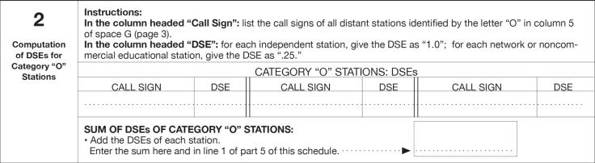
Part 2: Computation of DSEs for Category “O” Stations
Getting Started > Account Info > Revenues > Fees > Certification > Interest > DSE > Contact
Call Sign: List the call signs of all distant stations identified by the letter O in column 5 of space G (Page 3)
DSE: For each independent station, give the DSE as 1.0; for each network or noncommercial educational station give the DSE as .25
Sum of DSEs of Category O Stations: Add the DSE’s of each station (enter the sum on line 1 of part 5)

Slide 36
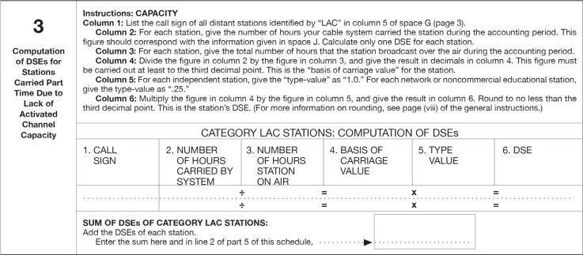
Part 3: Computation of DSEs for
Stations Carried Part Time Due to
Lack of Activated Channel Capacity
Getting Started > Account Info > Revenues > Fees > Certification > Interest > DSE > Contact
If applicable, determine the DSE value for each distant “LAC” station and enter the sum here and on line 2 of part 5

Slide 37
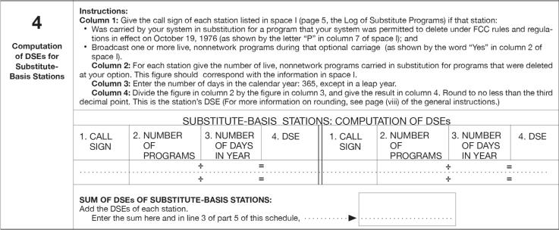
Part 4: Computation of DSEs for Substitute-Basis Stations
Getting Started > Account Info > Revenues > Fees > Certification > Interest > DSE > Contact
If applicable, determine the DSEs for any substitute-basis stations carried by the system and enter the sum here and on line 3 of part 5.

Slide 38
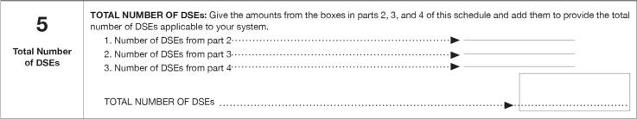
Part 5: Total Number of DSEs
Getting Started > Account Info > Revenues > Fees > Certification > Interest > DSE > Contact
Total Number of DSEs: Add the amounts from lines 1 through 3.
1. Number of DSEs from part 2
2. Number of DSEs from part 3
3. Number of DSEs from part 4
Total Number of DSEs

Slide 39
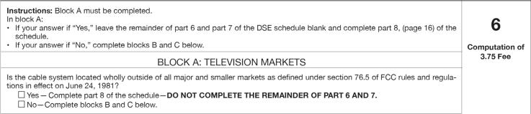
Part 6: Computation of 3.75 Fee
Getting Started > Account Info > Revenues > Fees > Certification > Interest > DSE > Contact
If any portion of the cable system is located within a major or smaller television market as defined by the FCC rules and regulations in effect on June 24, 1981, complete part 6 and part 7, if applicable.

Slide 40
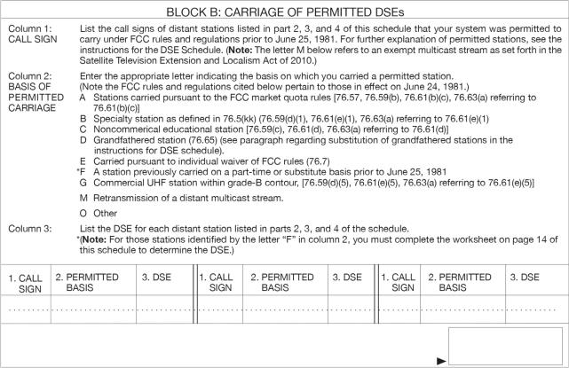
Part 6: Computation of 3.75 Fee
(continued)
Getting Started > Account Info > Revenues > Fees > Certification > Interest > DSE > Contact
Provide a permitted basis of carriage for all applicable distant stations.
Complete the worksheet in block B to determine the portion of the DSE exempt from the
3.75 percent fee.
Complete the log for all “F” permitted basis of carriage signals.

Slide 41
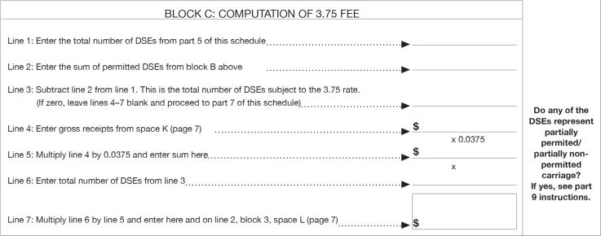
Part 6: Computation of 3.75 Fee
(continued)
Getting Started > Account Info > Revenues > Fees > Certification > Interest > DSE > Contact
Subtract the number of permitted DSEs from the total DSEs reported in part 5.
That result is the total number of DSEs subject to the 3.75 percent rate.
Determine if the 3.75 percent rate is calculated here or in part 9.

Slide 42
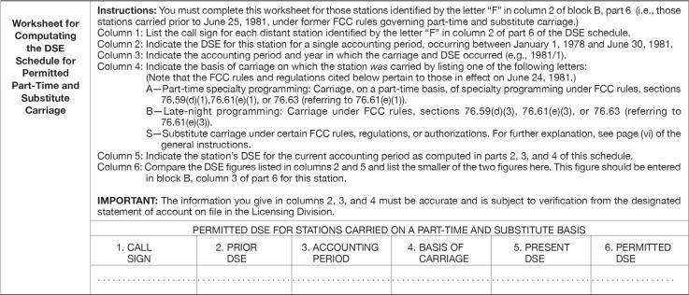
Part 6: Computation of 3.75 Fee
(continued)
Getting Started > Account Info > Revenues > Fees > Certification > Interest > DSE > Contact
IMPORTANT: The information you give in columns 2, 3, and 4 must be accurate
and is subject to review from the designated statement of account on file in the Licensing Division.

Slide 43
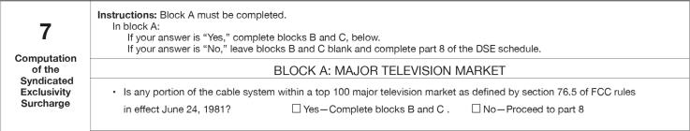
Part 7: Computation of the Syndicated Exclusivity Surcharge
Getting Started > Account Info > Revenues > Fees > Certification > Interest > DSE > Contact
Determine if any portion of the cable system is located within a top 100 television market as defined by the FCC rules and regulations in effect on June 24, 1981. If no portion of the cable system is located in a major television market, answer “No” in block A and move on to part 8.

Slide 44
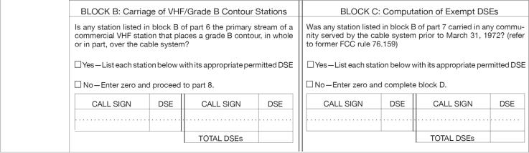
Part 7: Computation of the Syndicated Exclusivity Surcharge (continued)
Getting Started > Account Info > Revenues > Fees > Certification > Interest > DSE > Contact
Determine which station(s) reported in block B, part 6 are commercial VHF stations and place a grade B contour, in whole, or in part, over the cable system. If none of the stations qualify, answer “No” to block B and move on to part 8.
Determine which of the stations reported in block B, part 7 of the DSE Schedule were carried before March 31,1972. These stations are exempt from the FCC’s syndicated exclusivity rules in effect on June 24, 1981. Report these stations in block C. If you qualify to calculate the SES fee based upon the carriage of partially-distant stations, and you elect to do so, you must compute the surcharge in part 9 of this schedule. Otherwise compute any SES fee in block D, part 7.

Slide 45
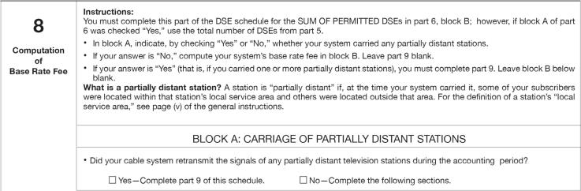
Part 8: Computation of Base Rate Fee
Getting Started > Account Info > Revenues > Fees > Certification > Interest > DSE > Contact
If at least one station was partially distant or partially permitted, calculate the base rate fee in block A, part 9.

Slide 46
Part 9: Computation of Base Rate Fee and Syndicated Exclusivity Surcharge for Partially Distant Stations, and Partially Permitted Stations
Getting Started > Account Info > Revenues > Fees > Certification > Interest > DSE > Contact
If any of the stations were partially distant or partially permitted:
1. Identify the communities/areas represented by each subscriber group.
2. Divide all of your subscribers into groups. A particular subscriber group consists of all subscribers who are distant with respect to exactly the same complement of carried distant and permitted stations.
3. Determine the portion of the total gross receipts you reported in space K that is attributable to each subscriber group.
4. For each subscriber group, calculate the total number of DSEs for that group’s complement of permitted stations.
If your system is located wholly outside all major and smaller television markets, all DSEs are permitted and calculate the base rate fee. If any portion of your system is located in a major or smaller television market, list the stations reported as permitted in block B, part 6 and calculate the base rate fee.

Slide 47
Part 9: Computation of Base Rate Fee and Syndicated Exclusivity Surcharge for Partially Distant Stations, and Partially Permitted Stations (continued)
Getting Started > Account Info > Revenues > Fees > Certification > Interest > DSE > Contact
5. Calculate a separate base rate fee for each subscriber group, using:
(1) the applicable rates given above;
(2) the total number of DSEs for that group’s complement of stations; and
(3) the amount of gross receipts attributable to that group.
6. Add together the base rate fees for each subscriber group to determine the system’s total base rate fee. Carry this number to space L.
7. Repeat this process from step 4 for any non-permitted signals. Calculate a
3.75 percent fee for each group that applies. Carry figure to space L.

Slide 48
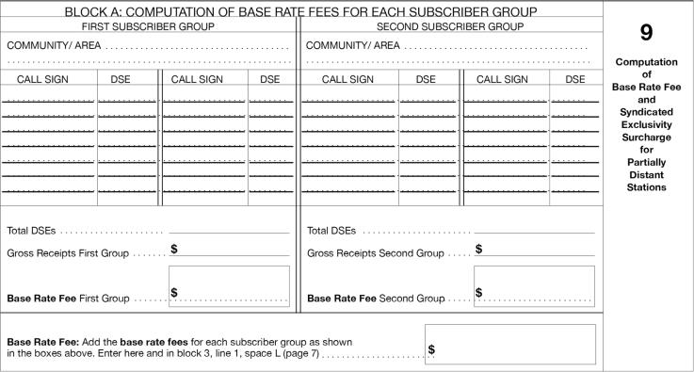
Part 9: Computation of Base Rate Fee and Syndicated Exclusivity Surcharge for Partially Distant Stations, and Partially Permitted Stations (continued)
Getting Started > Account Info > Revenues > Fees > Certification > Interest > DSE > Contact

Slide 49
Part 9: Computation of Base Rate Fee and Syndicated Exclusivity Surcharge for Partially Distant Stations, and Partially Permitted Stations (continued)
Getting Started > Account Info > Revenues > Fees > Certification > Interest > DSE > Contact
8. If any portion of the cable system is located in whole or in part within a major television market, you may also need to complete part 9, block B of the Schedule to determine the Syndicated Exclusivity Surcharge.
Compute the Syndicated Exclusivity Surcharge based upon these DSEs and the appropriate formula for the system’s market position.
Note: Multicast streams are not subject to the 3.75 fee or the SES fee.

Slide 50
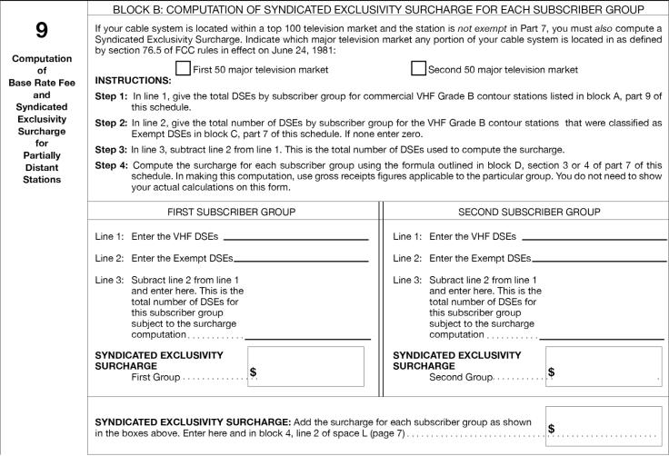
Part 9: Computation of Base Rate Fee and Syndicated Exclusivity Surcharge for Partially Distant Stations, and Partially Permitted Stations (continued)
Getting Started > Account Info > Revenues > Fees > Certification > Interest > DSE > Contact

Slide 51
You have now completed the
online cable SOA tutorial
Getting Started > Account Info > Revenues > Fees > Certification > Interest > DSE > Contact
You can exit here, or proceed to https://www.copyright.gov/forms/sa3.pdf to access the
fillable PDF version of SA3 or https://www.copyright.gov/forms/sa3e.xlsx to access the electronic Excel form. For additional information about filing your statement of account electronically, visit www.copyright.gov/licensing/sec_111.html.
Remember to
  read all directions carefully before filling out the form;
  file an original (and, if by mail, one copy) of the completed SOA form;
  make your royalty and filing fee payments using www.pay.gov or other
  acceptable options. For details, see Circulars 74a, 74b, and 74c and the pay.gov tutorial at http://www.copyright.gov/licensing/index.html; and
  submit your SOA and royalty and filing fees on time.
If you still have questions, contact the Licensing Division at licensing@copyright.gov or
(202) 707-8150.

